Slide 1
Maths at Caythorpe

Slide 2
What are the national curriculum aims?
The National Curriculum 2014 has 3 central aims:
Become fluent
Reason mathematically
Can solve problems
What do these mean? How do they link?

Slide 3
These elements are all linked

Slide 4
Teaching for mastery approach

Slide 5
White rose scheme of learning
At Caythorpe school we use the White Rose Hub scheme of learning to ensure a clear sequence of progression across the school.
This is proven to raise standards on mathematics and is used in some way within 80% of UK schools.
We supplement the scheme of learning with a wide range of other teaching resources.

Slide 6
White rose scheme of learning
https://whiterosemaths.com/resources?year=year-5-new

Slide 7
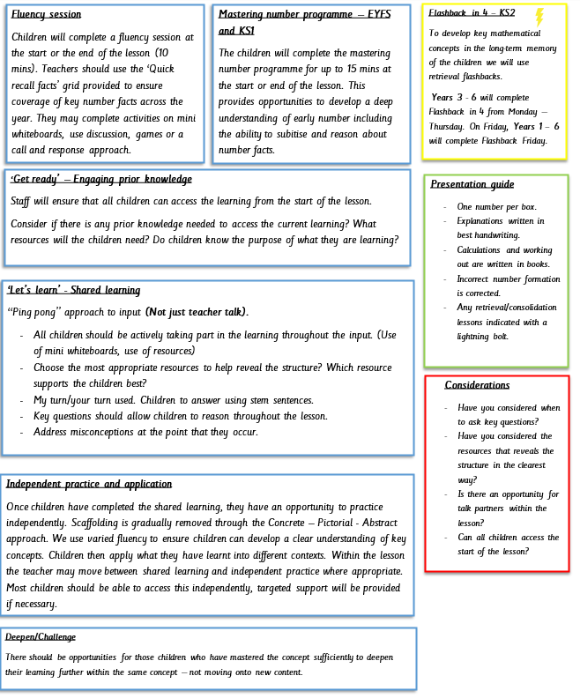

Slide 8
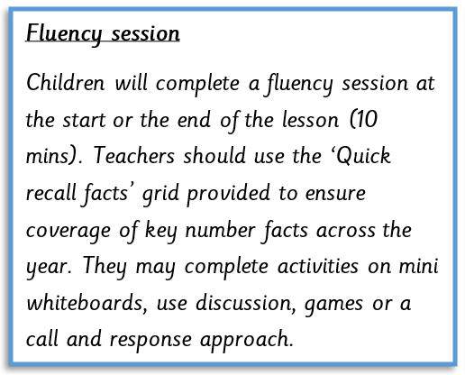
Fluency at Caythorpe
Being fluent in mathematics means to be accurate, efficient and flexible. How do we achieve this?
Subitising
Partitioning
Related facts
Spotting patterns
Making links
Notes:
Children who are not fluent in number bonds, times tables and other key facts will create cognitive overload.

Slide 9
Terminology
Efficiency – using an appropriate strategy or algorithm (with speed)
Accuracy – finding correct solutions
Flexibility – adapting strategy and transferring across contexts
We consider someone to be fluent in a technique, procedure, idea, concept or facts at the point at which they no longer need to give it attention.”
McCourt, 2019, p.43

Slide 10
Lets try an example
3 x 4 =
3 x 40 =
40 x 3 =
30 x 4 =
30 x 40 =
By completing an activity like this we are developing children’s fluency in a number of different areas.
Times tables, Commutative Law, scaling up in multiples of 10.
The variation in the questions is key to developing children’s understanding.
There will be an activity in the workshop to explore using efficient methods.

Slide 11
Why do we need to memorise facts?
One element of fluency, which is arguably the first one that comes to mind, is memorisation of key facts. These include number bonds and timetables’. Why is it important?
If children are not automatically able to recall these key facts they spend time trying to work these out, when working on more complex problem or other mathematical concepts. This can lead to cognitive overload which can be frustrating and lead to children losing their love for mathematics.
Memorising facts is not what maths is about – but it is an essential tool that leads children into effective mathematical thinking.
This is an area that can really benefit from support at home. – Little and often works best!

Slide 12
Links to games for improving fluency
https://www.topmarks.co.uk/maths-games/hit-the-button
https://www.mathplayground.com/number_bonds_20.html
Dice games - https://www.funlearning.co.uk/blog/dice-games-children-make-maths-exciting/
Dominoes
Number line games - https://nrich.maths.org/6589

Slide 13
Get Started
Teachers carefully plan to ensure all children have the required knowledge to be able to access the learning. Furthermore they will use real life examples to ensure children know the purpose of their learning.

Slide 14
Shared learning
Model examples of the concept using a range of pictorial representations.
Use Ping pong style approach to teaching (I do, we do, you do)
Remove scaffolding in small steps.
Includes variation.
Use stem sentences. Both adults and children.
Discuss the effectiveness and efficiency of strategies used.
Notes:
Children will complete learning with concrete resources or whiteboards
Go online to show examples of slides and worksheets

Slide 15
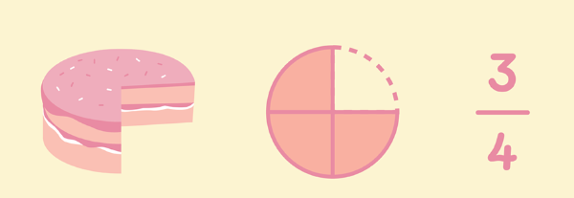
CPA Approach
We use a CPA approach as part of teaching for mastery.
This stands for Concrete, Pictorial, Abstract

Slide 16
CPA Aproach
At Caythorpe, we recognise that the Concrete Pictorial Abstract (CPA) approach is highly effective in the teaching of Maths to develop conceptual understanding. This approach will vary between year groups and the individual abilities of children within each class.
Objects, pictures, words, numbers and symbols are everywhere. The mastery approach incorporates all of these to help children explore and demonstrate mathematical ideas, enrich their learning experience and deepen understanding. Together, these elements help cement knowledge so pupils truly understand what they’ve learnt.
All pupils, when introduced to a key new concept, should have the opportunity to build competency in this topic by taking this approach. Pupils are encouraged to physically represent mathematical concepts. Objects and pictures are used to demonstrate and visualise abstract ideas, alongside numbers and symbols.

Slide 17
Resources we use
Counters
Cubes
Numicon
Tens frames
Base 10
Place value charts
Cuisenaire rods
Fraction walls
Bar models

Slide 18
Independent practice
Pupils work through more examples independently with the teacher supporting them if necessary.
Questions contain lots of mathematical variation – they are designed to extend pupil’s thinking rather than just lots of examples presented in the same kind of way.
Teacher use a ‘checking lens/live marking’ to ensure children in class are grasping the concept – they will pull out small groups if necessary to revisit the concept. – This is not always the same children.
Children should have access to concrete resources with the view to them eventually working without them.
Where possible children are encouraged to record their mathematical thinking on squared paper as this helps them to organise their work clearly.

Slide 19
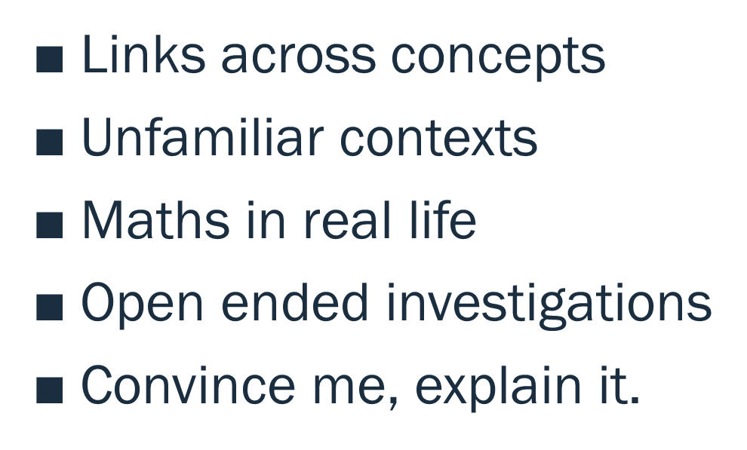
Apply and deepen
White rose hub premium resources.
Diving into mastery
Test base
Nrich (Website)
NCETM
Self produced

Slide 20
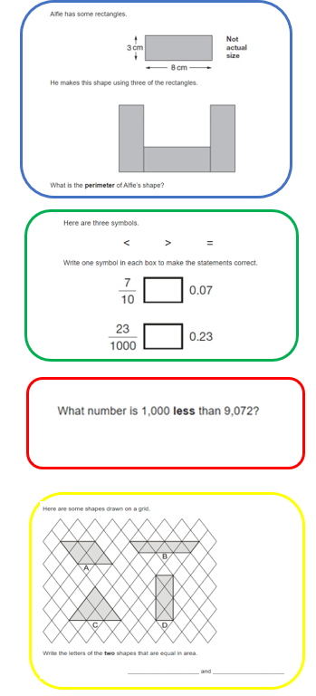
Flashback Friday
Blue – Previous week
Green – Previous term
Red – Previous year
Yellow – Pre teach

Slide 21
Importance of stem sentences
Sentence stems are a written scaffold which provide students the opportunity to effectively respond using complete sentences. ... Sentence stems can be used at any point, in any lesson, to structure meaningful conversation.
For example:
___ is the whole. ____ is a part, ____ is a part. Adding all the parts equals the whole.
There are ___ ones, ___ tenths and ____ hundredths. The number is _______
https://wsap.academy/maths-cpd-for-staff/ - video

Slide 22
How can you help at home?
Encourage children to play TTRockstars or practice timetables, if you cannot access the app (little and often is the key) – For example, 5 mins a day. Let us know if your child can’t log in
Explore maths in ever day contexts:
Telling the time
Baking (weighing and measuring)
Shopping (finding change, working out percentages, finding totals of amounts.)
Managing their own budgets.
Planning meals/parties etc (Multiplication, Division, fractions, percentages)
Talk to children about the maths they see in the everyday world.
Practice other quick recall facts – little and often (See quick recall document that has been printed)

Slide 23
Calculation strategies
If you are ever unsure about how to support with solving calculations and at home or would just like to know the methods that we teach the children, then please just ask.
Methods may be taught slightly differently from when you were at school – it doesn’t mean either way is wrong but it may help to alleviate any confusion amongst the children.
We teach for understanding – not quick tricks – These may work in the sort term but create difficulties when children move through school and beyond in their mathematical education. For example, adding a zero when multiplying by 10
42 x 10 = 420 but 4.2 x 10 = 4.20 (This trick can confuse children)

